Slide 1
Design and Development of Online Environment Monitoring System
(oems)

Slide 2
CONTENTS
INTRODUCTION
CONCEPT OF IOT
OBJECTIVES
BLOCK DIAGRAM
FLOW CHART
REQUIRED COMPONENTS
OVERVIEW OF ARDUINO
OVERVIEW OF ETHERNET SHIELD
OVERVIEW OF DHT11 SENSOR
OVERVIEW OF MQ-6 SENSOR
OVERVIEW OF BMP180 SENSOR
HARDWARE
HTML PAGE WITH SENSOR DATA
APPLICATIONS
CONCLUSION
REFERENCES

Slide 3
INTRODUCTION
Environment is a very important factor in almost every field starting from human survival to any working field. So we are intruding a system which can be used to monitor environmental details. This system is based on Internet of Things (IoT) which makes it a location independent system and can be accessed from any part of the world via internet. This basic proposed system will give you the details of temperature, humidity, pressure, altitude and presence of flammable gas in a particular location. Not only that, it can be further modified according to the needs of environmental details. As this system can be controlled from internet, one can remotely monitor the sensor details and if the values cross a threshold limit, necessary actions can be taken immediately.

Slide 4
Concept of IoT
By the name one can easily define IoT as ‘Things’ which are connected to internet. Here ‘Things refer to the devices and everyday objects, from small ones (like wrist watch) to really big ones (like robots, cars). No matter what definition one may find about Internet of Things, the main concept behind every IoT technology and implementation is the same: devices are integrated with the virtual world of internet and interact with it by sensing and monitoring objects and their environment.

Slide 5
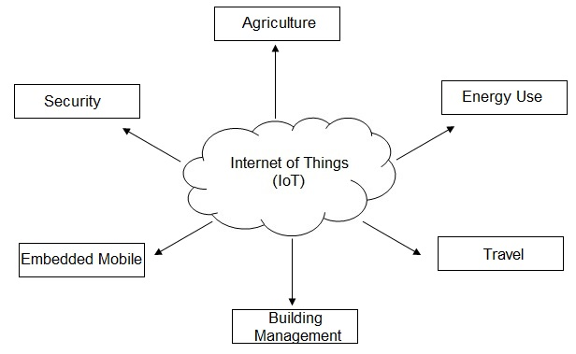
Concept of IoT

Slide 6
OBJECTIVES
The system will sense its surrounding environment by the respective sensors.
It will send the raw data to the CPU
The CPU will convert the raw data into human understandable form
The CPU will send these data along with the HTML code to the Ethernet Shield with an auto-refresh rate
Now the Ethernet Shield will send all (Data + HTML) to Internet or Router

Slide 7
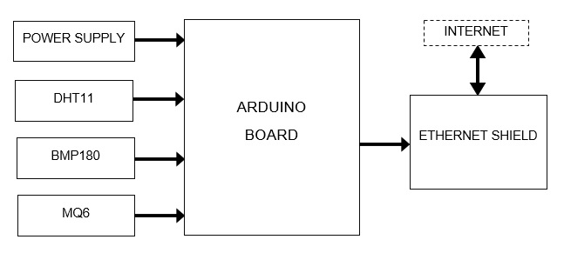
BLOCK DIAGRAM

Slide 8
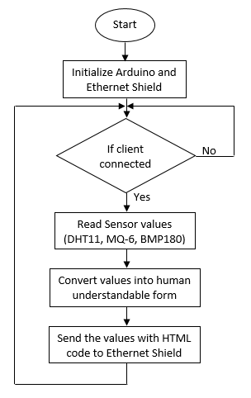
FLOW CHART

Slide 9
REQUIRED COMPONENTS
Arduino (ATmega 328p Microcontroller)
Ethernet Shield
Temperature and Humidity Sensor (DHT11)
LPG GAS Sensor (MQ-6)
Barometric Pressure Sensor (BMP180)
Router
Power Supply

Slide 10
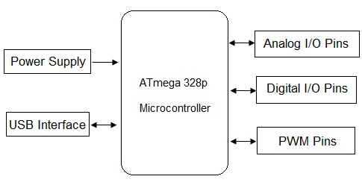
AN OVERVIEW OF ARDUINO
On board voltage regulator
Operating voltage is 5V
Operating frequency 16 MHz
14 digital I/O pins, of which
6 are PWM pins
6 ADC channel (10 bits)
32KB flash memory
(0.5KB for boot loader)
2 KB SRAM memory
1KB internal EEPROM
Programmable Serial USART
Master/Slave SPI Serial interface
I2C interface
Programmable watchdog timer with separate on-chip oscillator.

Slide 11
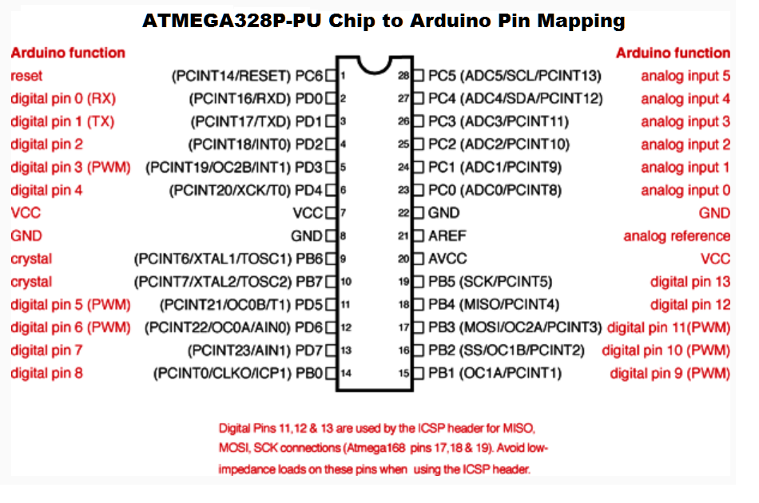
PIN DIAGRAM OF ATMEGA 328p μC

Slide 12
AN OVERVIEW OF ETHERNET SHIELD
It is based on the Wiznet W500 ethernet chip with 16K buffer
The Wiznet provides a network (IP) stack capable of both TCP and UDP
The shield has a standard RJ45 connector
It communicates with Arduino using the SPI bus
PWR: indicates that the board and shield are powered.
LINK: indicates the presence of network link and flashes when the shield transmits or receives data.
FULLD: indicates that the network is full duplex.
100M: indicates the presence of a 100 Mbps network connection (as opposed to 10 Mbps)
RX: flashes when the shield receives data
TX: flashes when the shield sends data
COLL: flashes when network collisions are detected

Slide 13
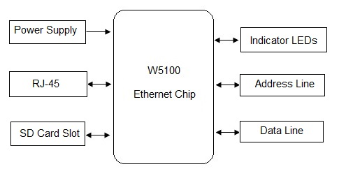
AN OVERVIEW OF ETHERNET SHIELD

Slide 14
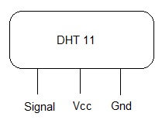
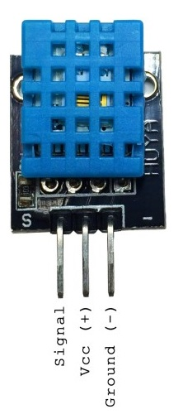
AN OVERVIEW OF DHT11 SENSOR
The DHT11 sensor is a Temperature and Humidity sensor in a single package
It includes a resistive-type humidity measurement component and an NTC temperature measurement component
It provides single-bus data communication interface
One communication process is about 4ms

Slide 15
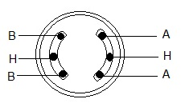
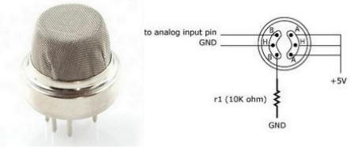
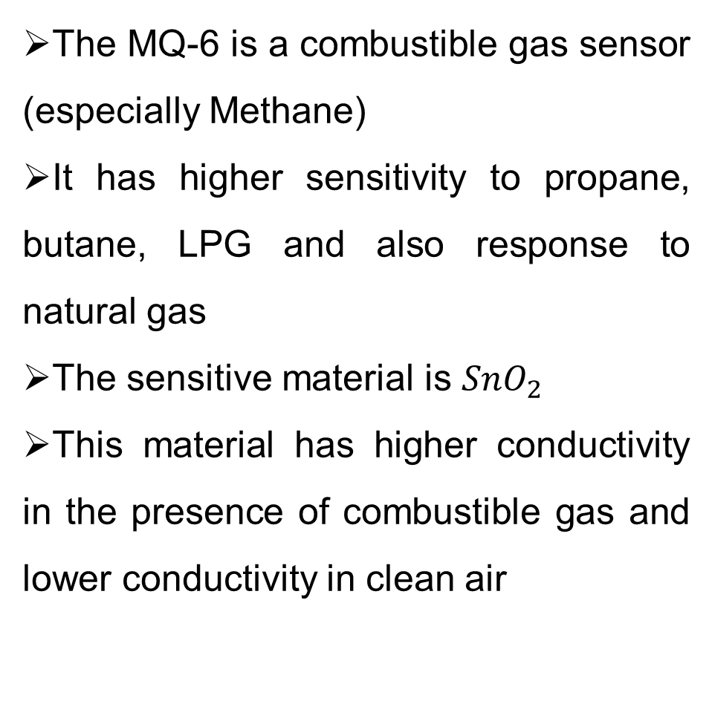
AN OVERVIEW OF MQ-6 SENSOR
The MQ-6 is a combustible gas sensor (especially Methane)
It has higher sensitivity to propane, butane, LPG and also response to natural gas
The sensitive material is ${SnO}_{2}$
This material has higher conductivity in the presence of combustible gas and lower conductivity in clean air

Slide 16
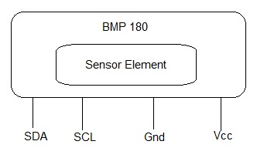
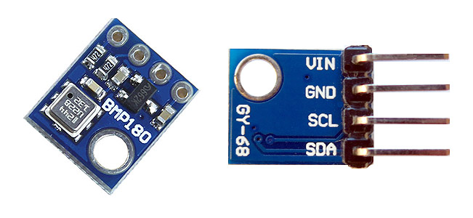
AN OVERVIEW OF BMP180 SENSOR
The BMP180 is a high precision pressure sensor
It consists of a piezo-resistive sensor, an ADC and a control unit with EEPROM.
It provides a standard I2C bus for connection with other system

Slide 17
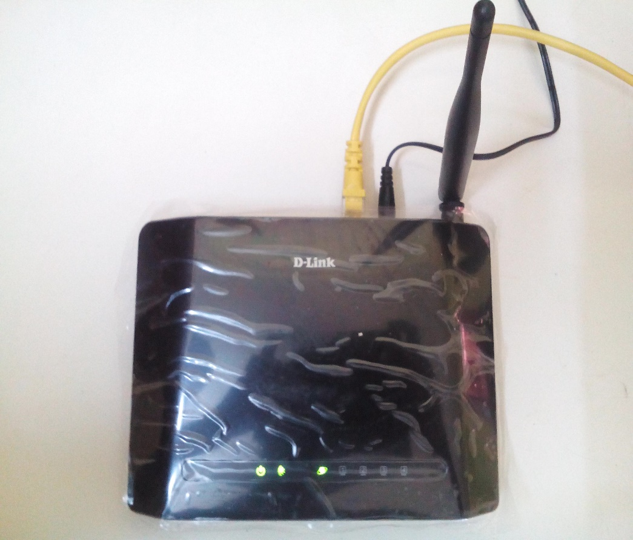
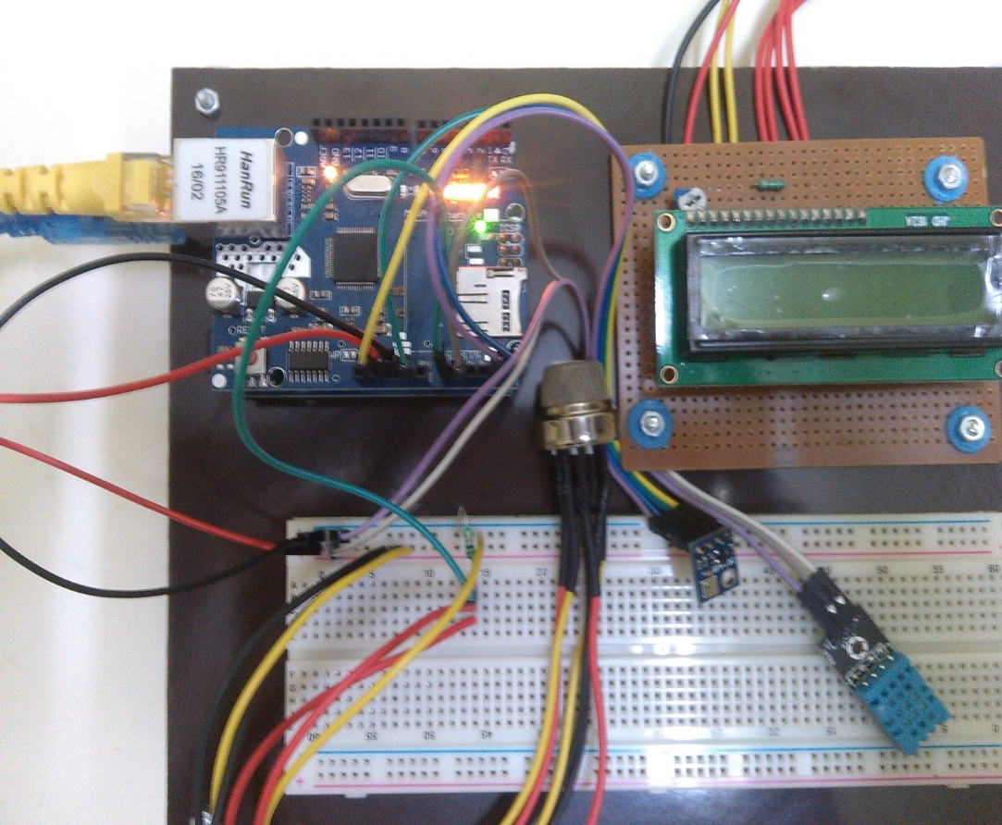
HARDWARE
Router
Arduino
With Shield
MQ-6
BMP180
DHT11

Slide 18
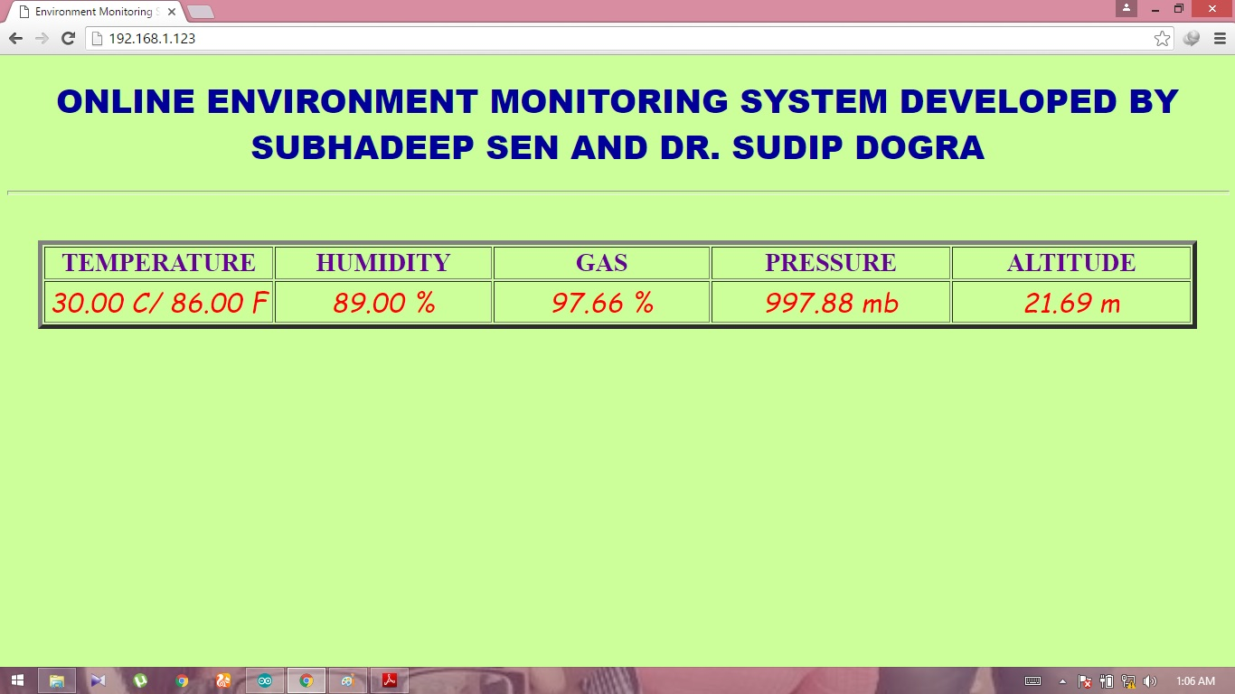
HTML PAGE WITH SENSOR DATA

Slide 19
APPLICATIONS
Weather Forecasting
Industrial Environment Monitoring
Home Environment Monitoring
Places which are beyond of reach

Slide 20
CONCLUSION
This system has a tremendous potential to be used in places where environment monitoring is necessary. It can be used in small applications such as home environment monitoring as well as in large application such as industrial environment observation or in places where environment is hostile and human being cannot reach by sending the system using bot.
Not only that, as the system keeps the scope of further development, one can easily changes the configuration according to the needs.

Slide 21
REFERENCES
Arduino:
https://en.wikipedia.org/wiki/ArduinoSIM900
Ethernet Shield:
https://www.arduino.cc/en/Main/ArduinoEthernetShield
DHT11:
www.micropik.com/PDF/dht11.pdf
MQ-6:
https://www.sparkfun.com/datasheets/Sensors/Biometric/MQ-6.pdf
BMP180:
https://www.adafruit.com/datasheets/BST-BMP180-DS000-09.pdf

Slide 22
THANK YOU

